Slide 1

ARTIFICIAL INTELLIGENCE
BY ASTHA MITTAL
https://en.m.wikipedia.org/wiki/Artificial_intelligence

Slide 2

INTRODUCTIONTO AI AI IS THE SIMULATION OF HUMAN INTELLIGENCE IN MACHINES.

Slide 3

KEY FEATURES OF AI
MACHINE LEARNING
NATURAL LANGUAGE PROCESSING
COMPUTER VISION
ROBOTICS
3

Slide 4
TYPES OF AI
TYPE | DESCRIPTION | EXAMPLES
NARROW AI | TASK-SPECIFIC INTELLIGENCE | SIRI, GOOGLE TRANSLATE
GENERAL AI | HUMAN- LIKE INTELLIGENCE (THEORITICAL) | NOT YET DEVELOPED
SUPERINTELLIGENT AI | SURPASSES HUMAN INTELLIGENCE | STILL HYPOTHETICAL
NARROW AI
GENERAL AI
SUPERINTELLIGENT AI

Slide 5
APPLICATIONS OF AI
HEALTHCARE - DISEASE PREDICTION, ROBOTIC SURGERY
TRANSPORTATION - SELF- DRIVING CARS, TRAFFIC CONTROL
E-COMMERCE - PERSONALIZED RECOMMENDATIONS
SMARTPHIONES - VOICE ASSISTANTS, FACE UNLOCK
FINANCE - FRAUD DETECTION, ALGORITHMIC TRADING
5

Slide 6
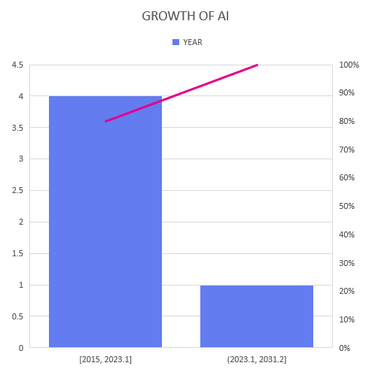
GROWTH OF AI OVER TIME
YEAR | MARKET SIZE
2015 | 9.5
2018 | 21.5
2021 | 62.3
2023 | 95.6
2025 | 190+

Slide 7
THANK YOU

